Slide 1

MODULE 3
COMPENSATION & BENEFITS
aPHRi
Marie-Ann Ocansey

Slide 2
DISCLAIMER
The following set of slides contains proprietary information that requires attribution to various sources. It is for the purposes of training only and should not be reproduced or circulated since copyright laws may be applicable.

Slide 3
TOTAL REWARDS:
FINANCIAL & NON-FINANCIAL
1
Compensation & Indirect Comp:
Inducements:
Rewards for Work
People are willing to
work for the inducements or rewards they receive from working.
An employment
exchange occurs when there is a balance between the inducements offered by the organization and the contributions made by the employees.
Financial Compensation
Non-financial Compensation
Incentives
Direct Pay
Job Content
Merit Pay
Piece rate
Incentives
Bonuses
Group Incentives
Gain Sharing
Profit Sharing
Executive Incentives
Wages
Salary
Interesting duties
Responsibilities
Achievements
Recognition
Challenges
Advancement
Job Environment
Benefits
Comfortable Working Conditions
Friendly Co-workers
Considerate Supervision
Status and Position
Fair Company Policies
Compatible Work Schedule
Health Care
Accident Insurance
Pay for Time Not Worked
Worker’s Compensation
Social Security
Employee Services

Slide 4
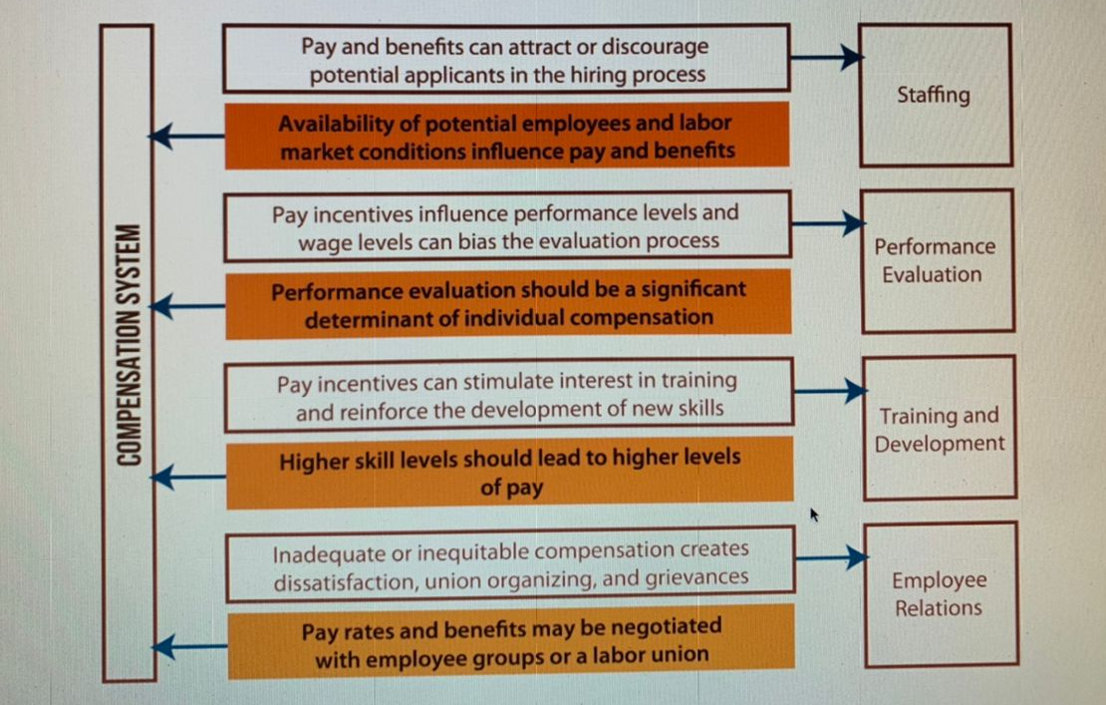
IMPACT ON OTHER HR FUNCTIONS

Slide 5
OBJECTIVES OF COMPENSATION
Pay decisions should satisfy six objectives and each of these objectives is important in developing a sound compensation system.
Legal
Motivating
Adequate
Equitable
Secure
Cost/Benefit Effective

Slide 6
STRATEGIC ALIGNMENT OF BASE & INCENTIVE PAY
In designing a compensation system, companies need to make a strategic decision regarding the best balance between base pay and incentive pay – what percentage of an employee’s pay should be base pay and what percentage should be incentive pay?
This issue concerns the proper balance between two compensation objectives: security & motivation.
How this issue is resolved is probably the most important consideration in aligning HR programs with the strategic direction of the organization.

Slide 7
ETHICAL CONSIDERATIONS IN COMP.
Compensation Maxim
Wage versus
Salary
Pay Secrecy versus Openness

Slide 8
DETERMINANTS OF PAY
External Factors
Organizational Factors
Market factors
Unions –settlements in other organizations
Geographical pay differences
Government regulations and laws
Social expectations (customs)
Industry in which the organization is located
Union or nonunion
Size, Profitability and ability to pay
Capital or labour intensive
Philosophies of the organization
Value of the job (contribution to the org.)

Slide 9
DETERMINANTS OF PAY
Job Factors
Individual Factors
Skill
Responsibility
Effort
Working conditions
Performance and Productivity
Experience
Seniority, length of service
Potential/ Promotability

Slide 10
THREE WAGE DECISIONS
Wage-level decision
Wage-structure decision
Individual wage decision

Slide 11
WAGE-LEVEL DECISION
2
The wage-level decision concerns the issue of pay adequacy.
This is a policy decision made by top management.
The org may decide to lead, match or lag in the market.
A sound wage-level policy is expected to achieve 3 objectives;
To attract an adequate supply of labor
To keep present employees satisfied with their comp.
To avoid costly turnover
Top management can decide to pay below or above the market level.
However, many other factors have impact on the pay levels and must be carefully looked at.

Slide 12
WAGE SURVEYS
The major tool for making wage-level decisions is the wage survey. These surveys collect information about the compensation and benefits of other employees in similar industries or in the same geographical region.
Government Surveys
Private Industry Surveys
Company-Sponsored Surveys
Effective surveys: Reciprocity, Anonymity, Low Cost, Timeliness
Methods:
Personal Interviews, Mailed Questionnaires, Telephone Inquiries

Slide 13
SURVEYS AND DATA ANALYSIS
Salary data may need to be aged, leveled, and/or factored for geography.
Aging uses movement in market rates to adjust outdated salary data.
Leveling adjusts salaries when surveyed jobs are similar but not identical to jobs in the organizations.
Since wage rates will vary by location, the organization should factor for geography any national salary survey data.

Slide 14
JOB EVALUATION & PRICING
3
The systematic approach of determining the relative worth or value of each job evaluation is to eliminate pay inequities and create a wage structure that identifies appropriate pay ranges for different jobs.
Determining how much each job should be paid relative to other jobs in the organization is called wage-structure decision.
Here, the amount of money is based on the job demands and not on how well the job holder performs ( although the wage structure must allow for individual variances based on performance, experience, and seniority).
Note that all jobs in the organization are not worth same.

Slide 15
WAGE STRUCTURE AND JOB EVALUATION
Job ranking Method
Classification/ Grading Method
Point Method
Factor Comparison Method
Guide Chart Profile-Method (Hay Method)
- Know-how
- Problem solving
- Accountability

Slide 16
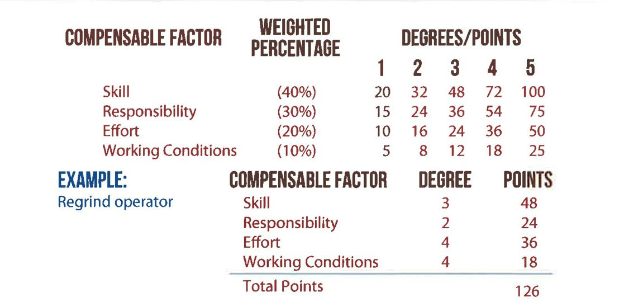
POINT METHOD

Slide 17
JOB PRICING
After the jobs have been arranged in a hierarchy of job worth, specific amounts of pay need to be associated with them. The process of placing a cedi value on the worth of a job is referred to as job pricing.

Slide 18
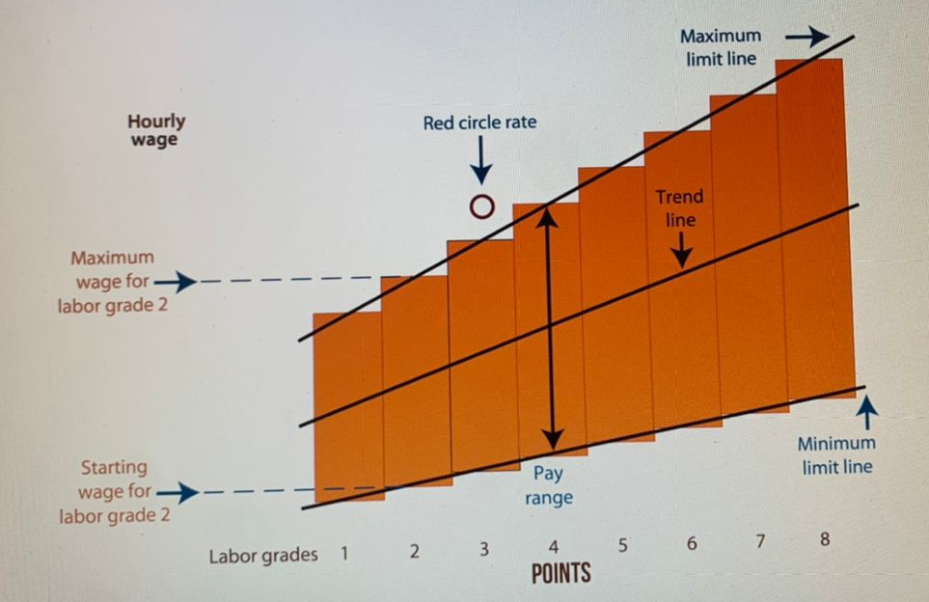
PAY GRADE AND PAY RANGES

Slide 19
CREATING A PAY STRUCTURE
Establish pay grades
• Group jobs that have the same relative internal or external worth.
• Pay the same rate or within the same pay range.
Set pay ranges
• Set upper/lower bounds of possible compensation for
individuals whose jobs fall in a pay grade.
• Market data from surveys used to determine a midpoint.

Slide 20
PAY VARIATIONS
Red-circle rates
Rates above the range maximum
Green-circle rates
Rates below the range minimum

Slide 21
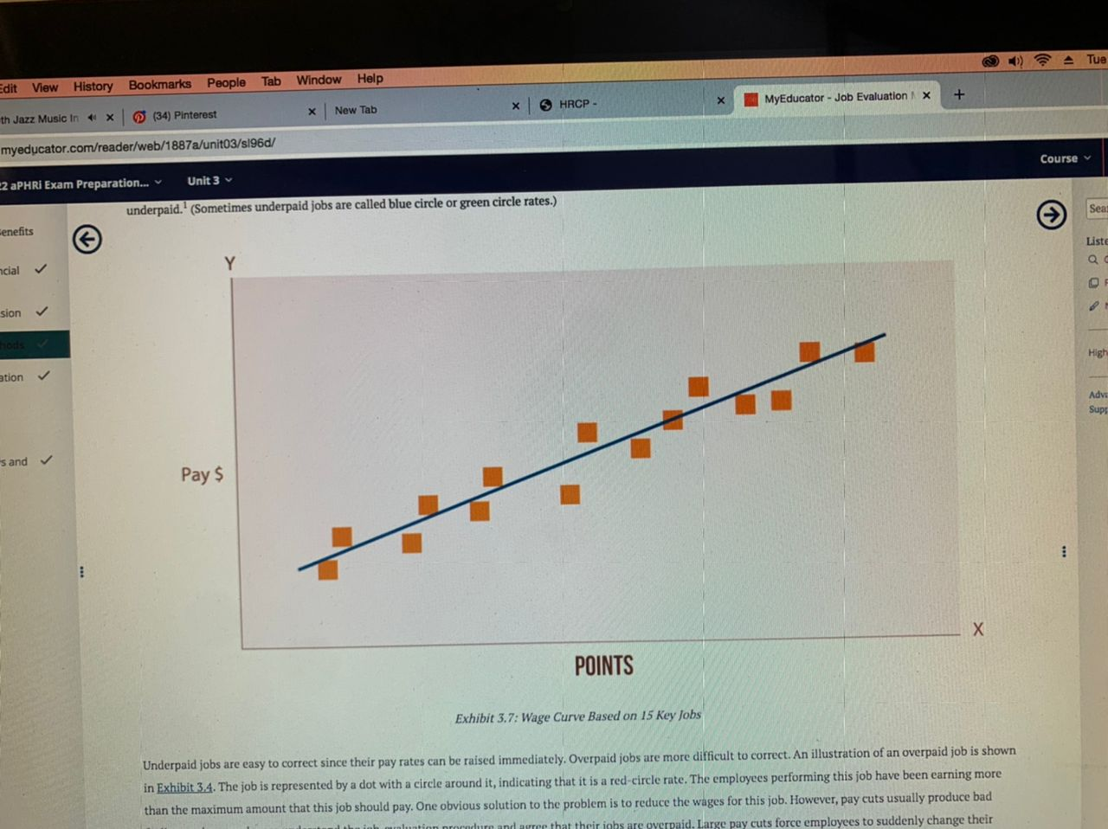
WAGE CURVE

Slide 22
INCENTIVE COMP SYSTEM
• Paying for performance beyond expectations.
• Motivates employees to perform at higher levels.
• May be a factor when determining overtime pay.
Note that there are tax ramifications for implementing incentive pay plans.
The wage-level decision concerns the issue of pay adequacy.
This is a policy decision made by top management. The org may decide to lead, match or lag in the market.

Slide 23
MERIT PAY SYSTEM/PERFORMANCE-BASED
Individual performance is the basis for pay.
Increases are tied to performance and job mastery.
Employers must be able to defend performance appraisal methods and differences in salary increases.

Slide 24
PERSON-BASED SYSTEM
Employee’s characteristics determine pay
Superior knowledge or skill mastery is rewarded
– Knowledge-based (scientists whose pay is based on
knowledge in a field or domain)
– Skill-based (machine operators cross-trained on a
variety of production equipment)
– Competency-based (professionals who excel at defined
competencies)

Slide 25
DIFFERENTIAL PAY
Shift pay
Emergency-shift pay
Premium pay
Hazard pay
On-call or call-back pay
Reporting pay
Travel pay
Based on when an employee works

Slide 26
PRODUCTIVITY-BASED SYSTEM
Pay is determined by employee’s output
• Straight piece-rate
− Base wage rate plus additional compensation for
output
• Differential piece-rate
− One piece rate up to the standard and a higher rate
after the standard is exceeded
Works best in assembly and manufacturing situations.

Slide 27
INDIVIDUAL INCENTIVE PLANS
Improve individual performance
Kept separate from base pay
Piece rates
Sales Commissions
Standard Hour Plans
Halsey Premium Plan
Bonuses

Slide 28
DIRECT SALES COMPENSATION
Straight salary
Straight commission
Salary plus commission
Use when:
There is a long sales cycle.
More time is spent on service than sales.
Goal is to increase volume and control costs.
Company needs to reward behaviors that support strategy.
Plan needs to be adaptable.

Slide 29
GROUP INCENTIVE PLANS
Gain sharing
Organization shares a portion of the gains
realized from group effort.

Slide 30
BENEFIT PROGRAMS

Slide 31
EMPLOYEE BENEFIT PROGRAMS
4
Indirect Compensation designed to:
Reward continued employment.
Help organizations recruit and retain talent.
Improve productivity, work quality & competitiveness.
Protect employees’ physical and financial well-being – even after employment.
Must be affordable for employers and attractive to employees.

Slide 32
GOVERNMENT MANDATED BENEFITS
Certain benefits are required by statute and cannot be dropped by the organization even if employees don’t want it.
Paid Time-Offs
Social Security
Workers’ Compensation

Slide 33
OTHER NONSTATUTORY BENEFITS
These are benefits at the discretion of the employer and may include:
Disability benefits
Life insurance
Long-term care insurance
Employee assistance program
Severance packages
Supplemental unemployment ben.
Paid leave
Paid-time-off
Care of dependents
Transfer assistance
Tuition reimbursement
Prepaid legal insurance

Slide 34
RECOGNITION & ACHIEVEMENT AWARDS
Recognition awards can be highly motivating.
Organizations use a variety of recognition programs to influence the attitudes and behaviors of employees.
The kinds of rewards companies use to recognize good behavior include:
Cash awards
Savings/ bonds
Shares/ stocks
Jewelry & clothing
Theater tickets
Extra vacation days
Dinner for two
Travel for two
Plaques
Pictures displayed on walls

Slide 35
HEALTH AND ACCIDENT INSURANCE
In some countries, health and accident insurance are optional benefits that employers can decide whether they want to offer.
Medical Insurance
Dental Care
Dependent Care

Slide 36
INCOME REPLACEMENT
Benefit plans can create a valuable feeling of security providing life insurance and various forms of income continuation. Accidents and illnesses that result in death are the most serious personal losses, but a permanent disability can also create a serious financial strain.
Disability (long-term disability, sick leave, long-term care insurance)
Life insurance
Severance Pay

Slide 37
EMPLOYEE SERVICES
Legal Assistance
A HOST OF EMPLOYEE SERVICES:
- stock purchase plans
- credit unions
- emergency loans
- tuition for employee and family
members
- wellness seminars
- etc.
Auto and Property Insurance
Retirement Counseling
Transfer and Relocation assistance

Slide 38
PAY FOR TIME NOT WORKED
Paid Holidays
Paid Vacations
Paid Personal Leave
Union Activities
Reporting Time
Sabbatical Leaves
Paid Funeral Leave
Casual Leave

Slide 39
RECOGNITION & ACHIEVEMENT AWARDS
Companies also use a variety of nonfinancial incentives to motivate and reward their employees. These programs, which include various award programs and suggestion systems, often have a greater impact on motivation and company loyalty than financial incentives.
Award Programs
Suggestion Systems

Slide 40
EMPLOYEE BENEFITS
Employee Preference Assessment: surveys
Cost-Benefit Analysis and Cost Management
- Benefit Plan Audits
- Coordination of Benefits
- Utilization Review
Communication of Benefit programs
- Total Reward Statement
*Compensation
*Health care benefits
*Insurance
*Vacation and leave
*Retirement
*Costs of employment
*Additional benefits -wellness, childcare, tuition, food.

Slide 41
EVALUATING THE TOTAL REWARDS SYSTEM
5
Is it in compliance?
Is it compatible with the organization’s mission and strategy?
Does it fit the culture? Is it appropriate for the workforce?
Is it internally equitable?
Is it externally competitive?

Slide 42
COST MANAGEMENT
Three variables combine to determine a firm’s labor costs:
The number of employees
The average cash compensation
The average benefit cost
Managing labor costs effectively requires a careful review of all three variables.
Labor costs =
employment x (average cash compensation + average benefit cost)

Slide 43


